Slide 1
BRIEFIFY - A Text Summarization tool
sivanantham d (210701250)
Gopal k (210701517)
CS19643 – Foundation of machine learning

Slide 2
AGENDA
Introduction.
Existing system.
Proposed system.
Architecture diagram.
Word flow..
Future enhancement.
Conclusion.

Slide 3
Introduction
BRIEFIFY is a powerful text summarization tool designed to condense lengthy documents into concise summaries, saving you time and enhancing productivity. Utilizing advanced natural language processing and machine learning, BRIEFIFY accurately extracts key points and main ideas from various text types. Its user-friendly interface allows for quick and customizable summaries, making it an essential tool for students, professionals, and anyone needing to efficiently process large amounts of information.

Slide 4
Proposed system
Requires user input as a .txt file
Involves tokenization, stopword removal, and splitting to prepare text data for further analysis and summarization.
Automated text summarization tool using NLP techniques.
Utilize algorithms such as cosine similarity and PageRank for semantic analysis.

Slide 5
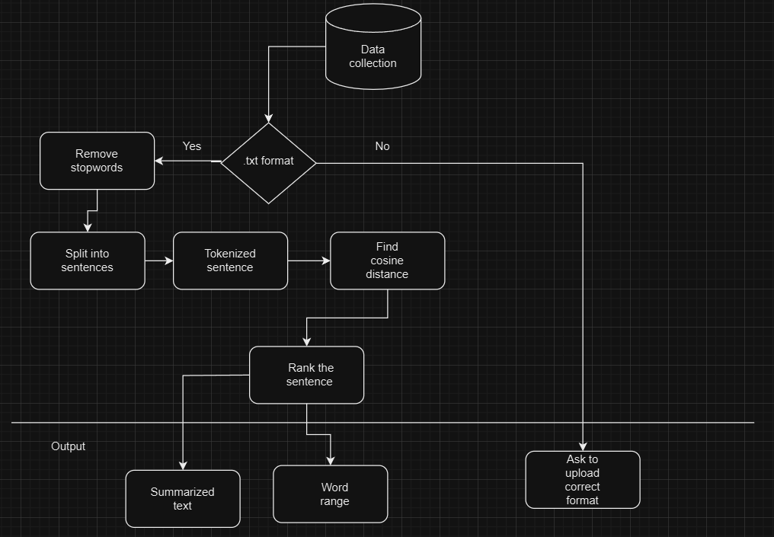
ARCHITECTURE DIAGRAM

Slide 6
modules
File Upload: Users upload a .txt file through the web interface.
Data Collection: The system verifies the file format, splits the text into sentences, and tokenizes each sentence into words, removing non-alphabetic characters.
Stopword Removal: NLTK's stopwords corpus filters out common English stopwords, ensuring only relevant words are processed.
Similarity Matrix Creation: Sentences are tokenized and preprocessed. Cosine similarity scores between sentence pairs are calculated, forming a similarity matrix.

Slide 7
5. PageRank Algorithm: Sentences are represented as nodes in a graph, with edges based on similarity scores. PageRank ranks sentences by importance.
6.Summary Generation: The highest-ranking sentences are selected to create the final summary.
7. Keyword Generation : Keyword generation using SpaCy involves processing text to extract significant words and phrases. First, the text is analyzed to identify named entities and noun chunks. These entities and chunks are then filtered and counted for frequency. The most common phrases are selected as keywords, representing the main topics of the text.

Slide 8
Applications
Educational Use: Assist students and educators in summarizing textbooks, study materials, and lecture notes for efficient study and review.
Academic Research: Quickly summarize research papers, articles, and thesis documents to grasp key points without reading through the entire content.
Professional Reports: Generate concise summaries of lengthy business reports, project updates, and meeting minutes, enhancing productivity.
Journalism: Summarize news articles and press releases, making it easier for journalists to extract essential information for their stories.
Legal Documents: Condense long legal documents, contracts, and case studies, helping lawyers and legal professionals quickly review important details.
Content Curation: Help content creators and curators summarize blog posts, online articles, and other digital content for easier content management and sharing.

Slide 9
Future Enhancement
Support for Multiple File Formats: Extend compatibility to include PDFs, Word documents, and web pages, making the tool more versatile.
Multi-Language Summarization: Implement support for summarizing text in multiple languages, catering to a diverse global audience.
Enhanced NLP Models: Integrate advanced NLP models, such as transformers, to improve the quality and coherence of summaries.
Customizable Summarization Parameters: Allow users to customize summary length, tone, and detail level to better meet their specific needs.
Integration with Cloud Services: Enable integration with cloud storage services like Google Drive and Dropbox for seamless file uploads and management.

Slide 10
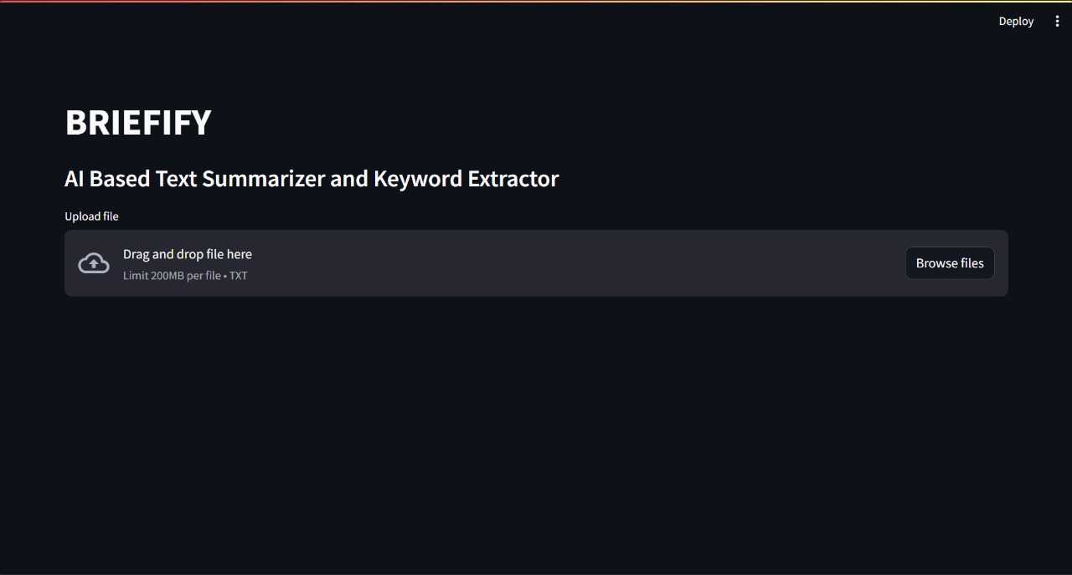
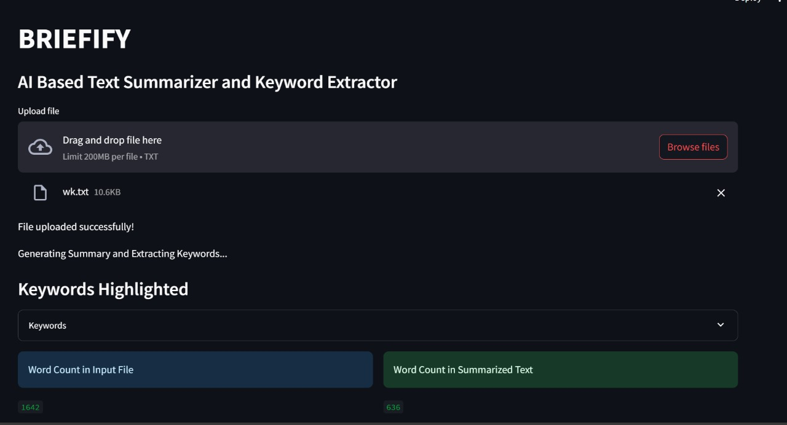
output
Home page
Result Page

Slide 11

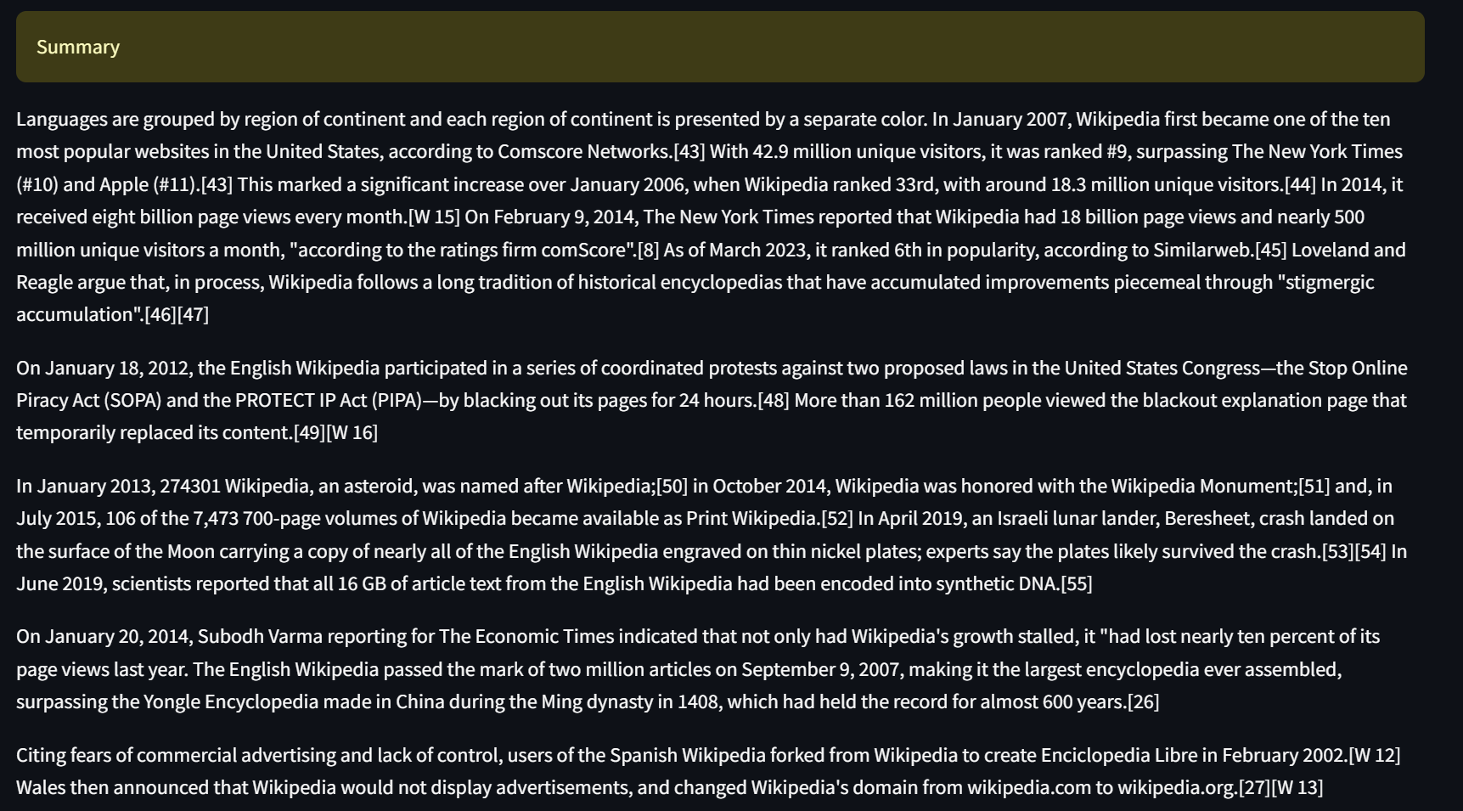
output
Extracted Keywords
Generated summary

Slide 12
Conclusion
In conclusion, "BRIEFIFY - A Text Summarization Tool" offers a streamlined solution for condensing lengthy texts into concise summaries. Its utilization of advanced algorithms and natural language processing enables users to extract key information efficiently, benefiting students, researchers, professionals, and others who require quick access to essential content. With its accuracy and effectiveness, BRIEFIFY stands as a valuable tool for enhancing productivity and comprehension in various fields.

Slide 13
THANK YOU

